Slide 1






ELECTRONIC MEASURMENTS PROJECT

Slide 2

TEAM MEMBERS
Sara Mohamed Fares Abdelhamed
Abdelrahman Yehia Sayed Ail
Mosab Mohamed Sayed Ahmed

Slide 3

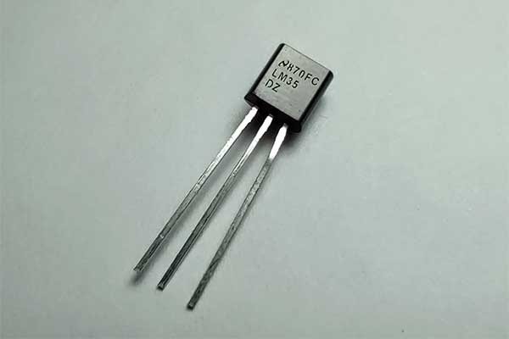

LED THERMOMETER
Under Supervision Of: Dr. Azza M. Anis

Slide 4

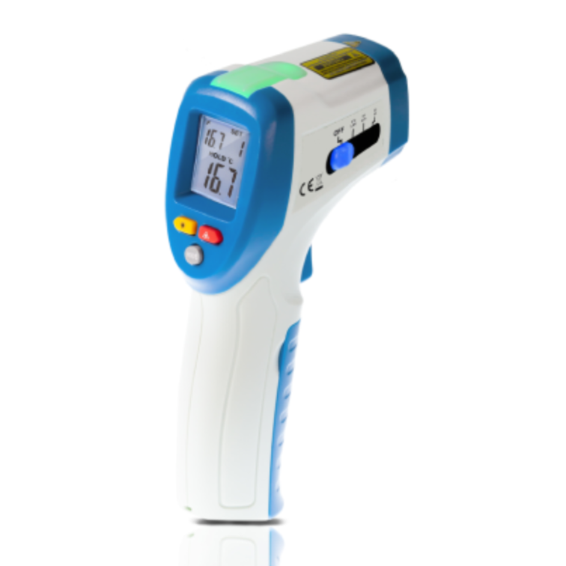

Introduction
In this project, we design and implement a simple yet effective LED thermometer using the LM35 temperature sensor and the LM3914 LED bar graph driver. The LM35 provides accurate analog temperature readings, which are then converted into a visual LED display by the LM3914, representing temperature levels in real-time. This system demonstrates how analog sensors and visual indicators can be integrated for quick and intuitive environmental monitoring.

Slide 5
LED THERMOMETER OBJECTIVE
To design and implement a real-time temperature monitoring system that visually indicates temperature levels using an LED bar graph display.

Slide 6

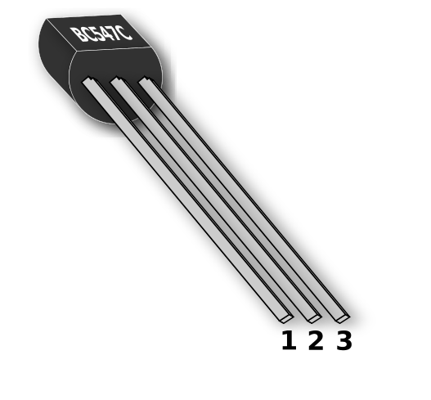



Components
1x LM3914 IC
1x LM35 Temperature Sensor
1x 100K Trimmer
2x 1K Resistor
1x 18K Resistor
1x 10K resistor
10x 5mm LED (4 Green, 3 Yellow, 3 Red)

Slide 7
KEY COMPONENTS EXPLANATION

Slide 8
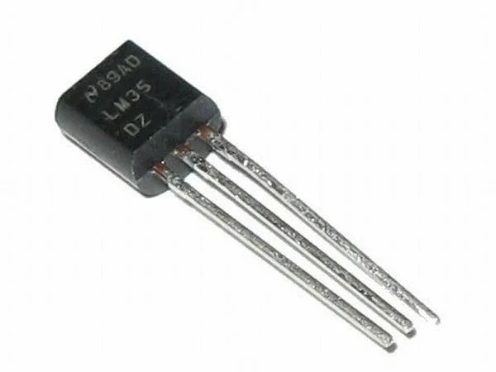
LM35 Temperature Sensor
The LM35 is a precision temperature sensor that provides an output voltage linearly proportional to the temperature in Celsius.
It is accurate, easy to use, and does not require external calibration.

Slide 9
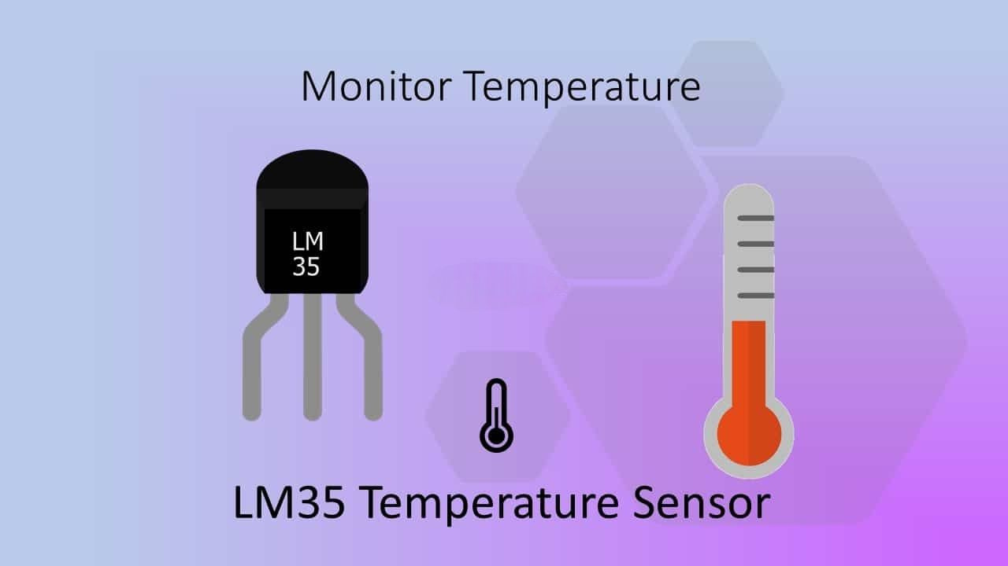

Slide 10
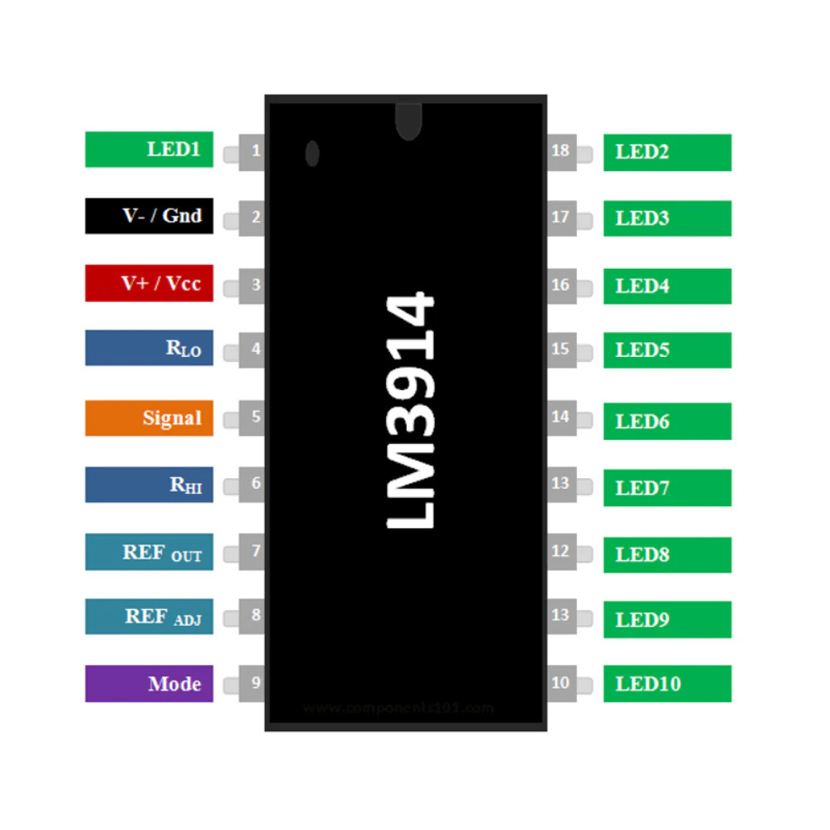
LM3914 IC
The LM3914 is an integrated circuit used to drive 10 LEDs in a bar or dot display mode.
It converts an analog voltage input into a visual LED level indicator, making it ideal for applications like LED thermometers and battery level meters.

Slide 11
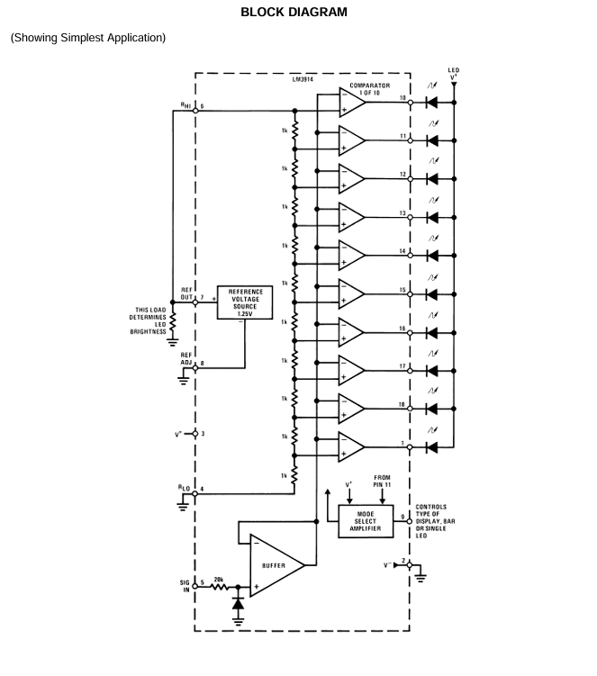
LM3914 IC Block Diagram

Slide 12
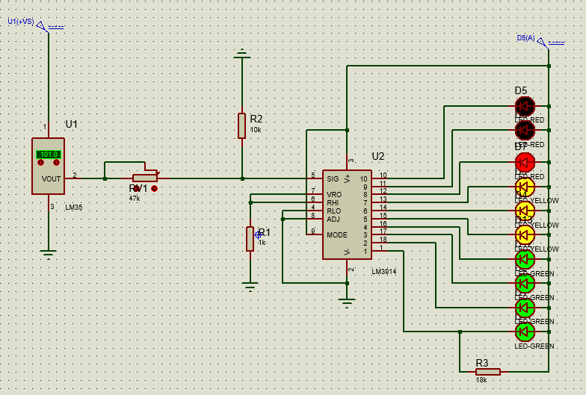
Simulation

Slide 13
RESULTS & TESTING
Successfully displayed temperature levels from 0°C to 150°C.
Smooth LED transitions as temperature increases.
System is responsive and intuitive for real-time monitoring.

Slide 14
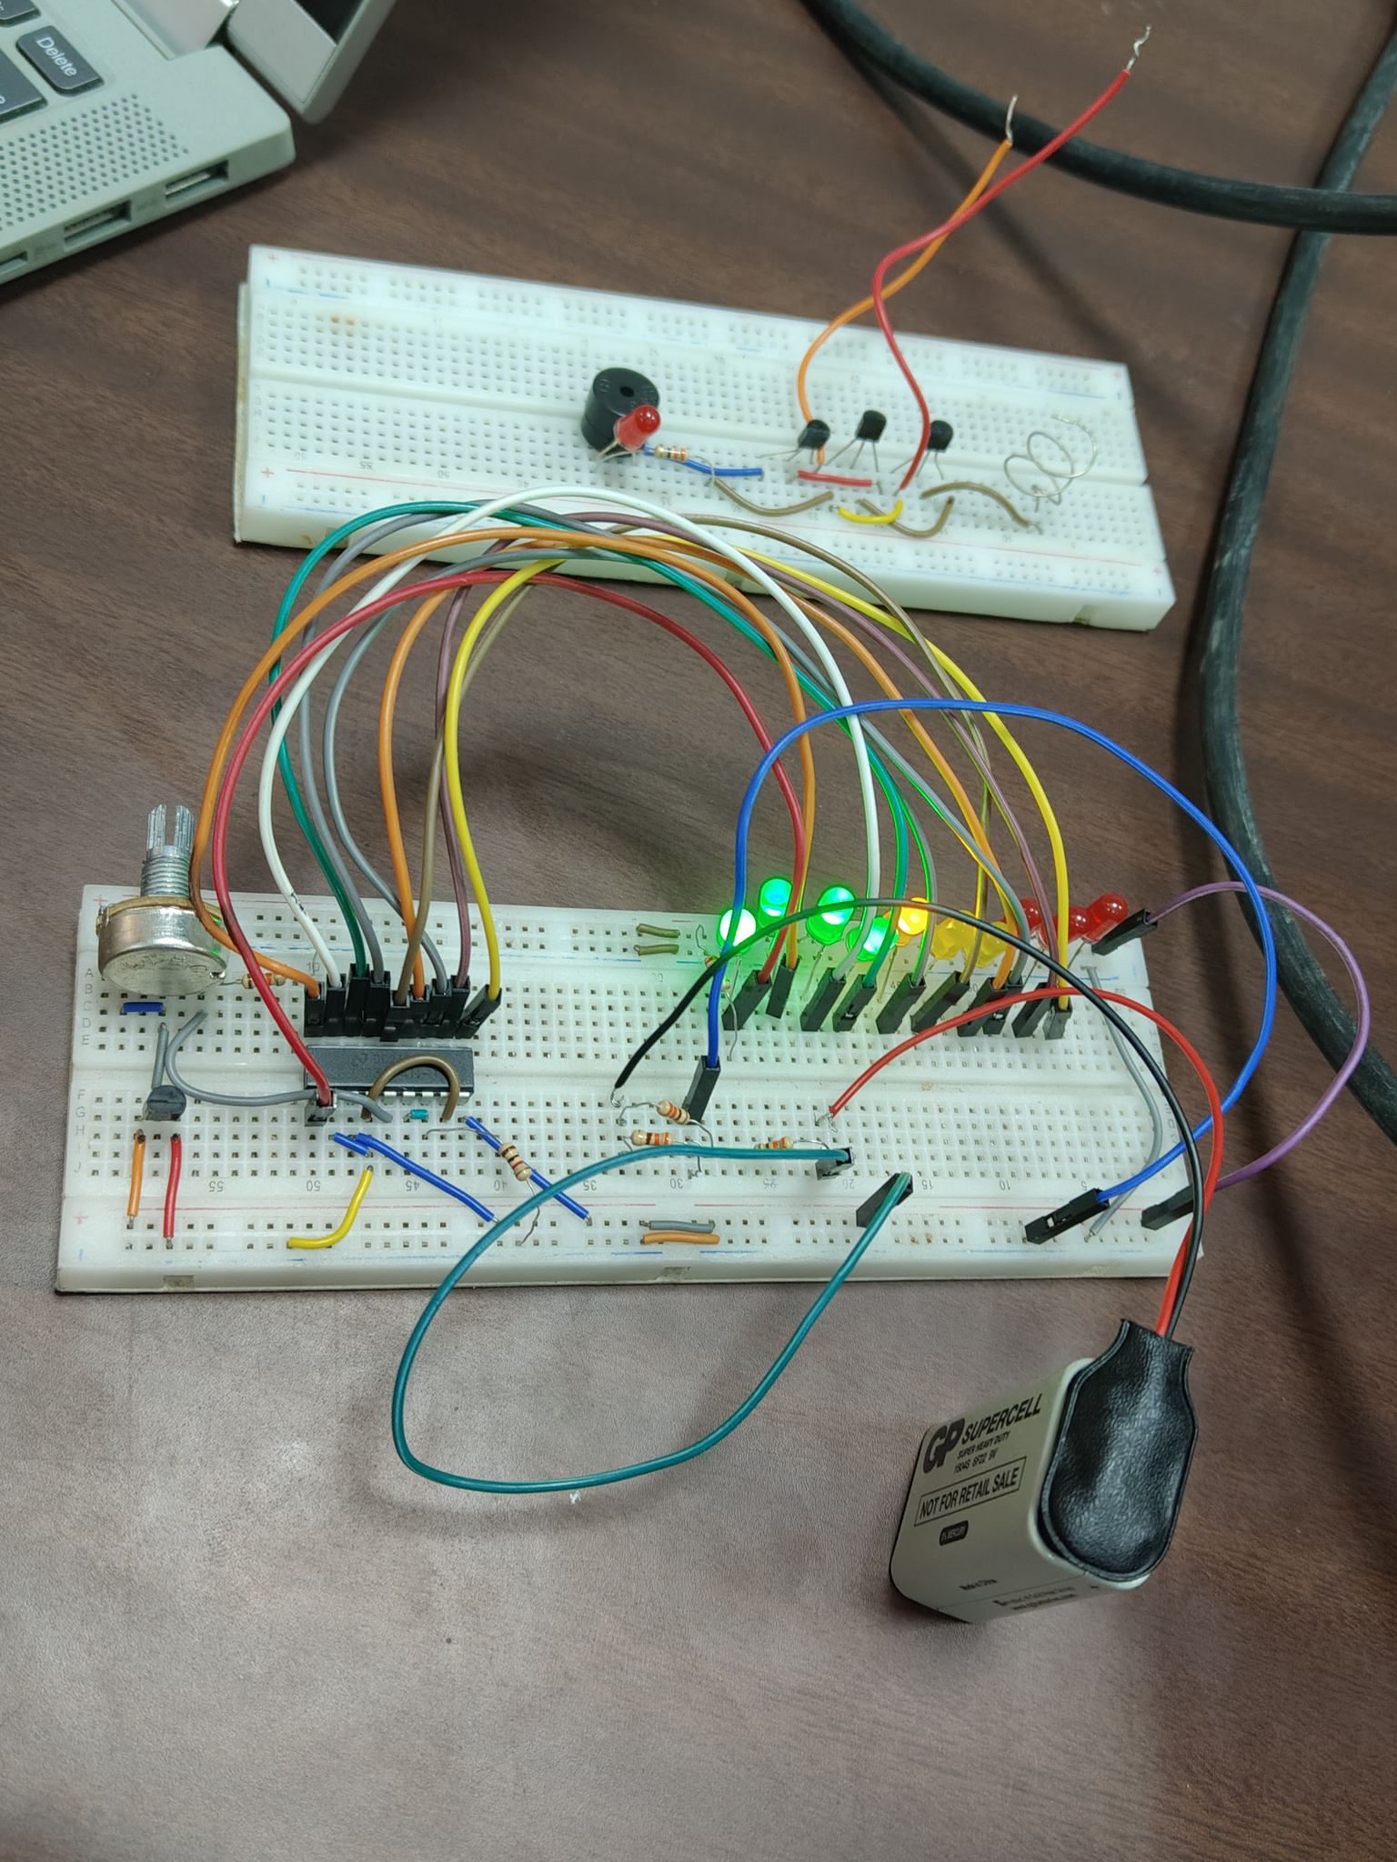
HARDWARE IMPLEMENTATION

Slide 15

HARDWARE IMPLEMENTATION

Slide 16


PRACTICAL APPLICATIONS
Server room temperature monitoring.
HVAC systems (Heating, Ventilation, and Air Conditioning).
Food processing industry temperature checks.

Slide 17
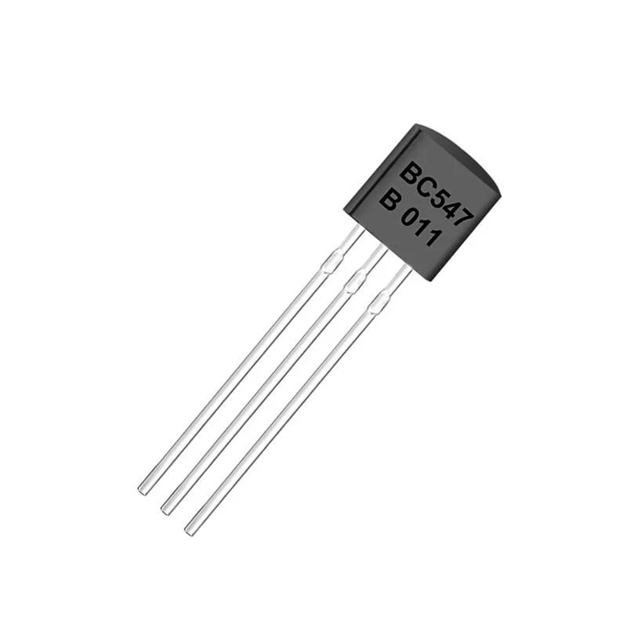
AC VOLTAGE
DETECTOR
Under Supervision Of: Dr. Azza M. Anis

Slide 18

Introduction
The AC Voltage Detector is a safety tool designed to detect the presence of alternating current (AC) voltage in electrical wires and outlets without direct contact. This project aims to build a simple and reliable device that helps users quickly identify live wires, preventing electrical accidents during maintenance and installation work. The detector uses a sensor circuit that senses the electric field generated by AC voltage and gives a visual or audible alert.

Slide 19
AC VOLTAGE DETECTOR OBJECTIVE
To build a simple and reliable device that detects the presence of AC voltage in wires and outlets without direct contact, enhancing safety during electrical work.

Slide 20


Components
x3 BC547 Transistors
3V Active Buzzer
1x 330 Ohm resistor
LED
Metal Coil

Slide 21
KEY COMPONENTS EXPLANATION

Slide 22
BC547 Transistors
The BC547 is an NPN bipolar junction transistor used for switching and amplification.
In the AC Voltage Detector, it amplifies the small signal detected from the AC source to drive the indicator circuit.

Slide 23

3V Active Buzzer
The 3V Active Buzzer is an electronic sound device that produces a tone when powered.
It contains a built-in oscillator, so it only needs a DC voltage to operate, making it ideal for alarms and alerts in projects like the AC Voltage Detector.

Slide 24
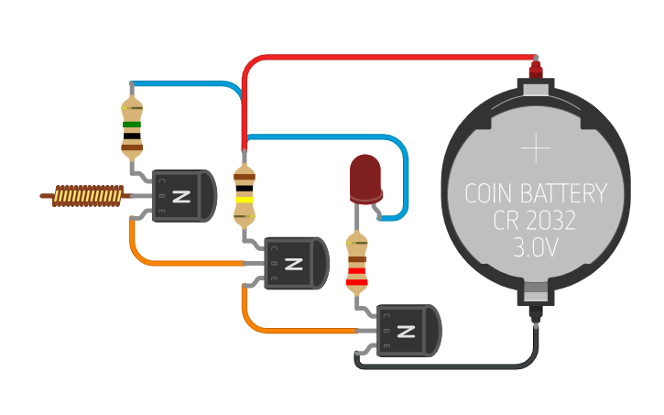

AC Voltage Detector Circuit

Slide 25
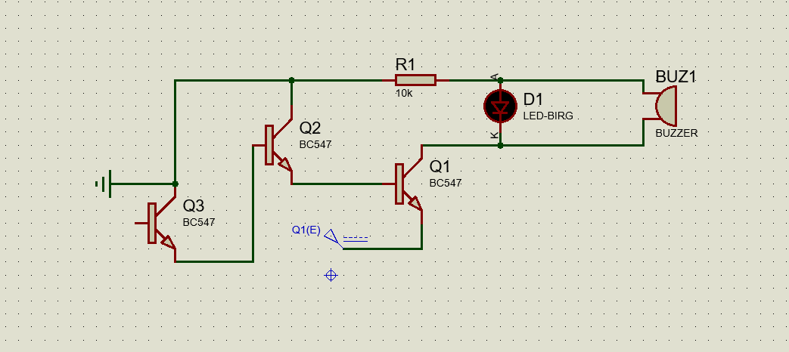
Simulation

Slide 26
RESULTS & TESTING
Successfully detected live wires without contact.
LED lights up and buzzer sounds when AC voltage is present.
Reliable and easy to use for safety checks.

Slide 27
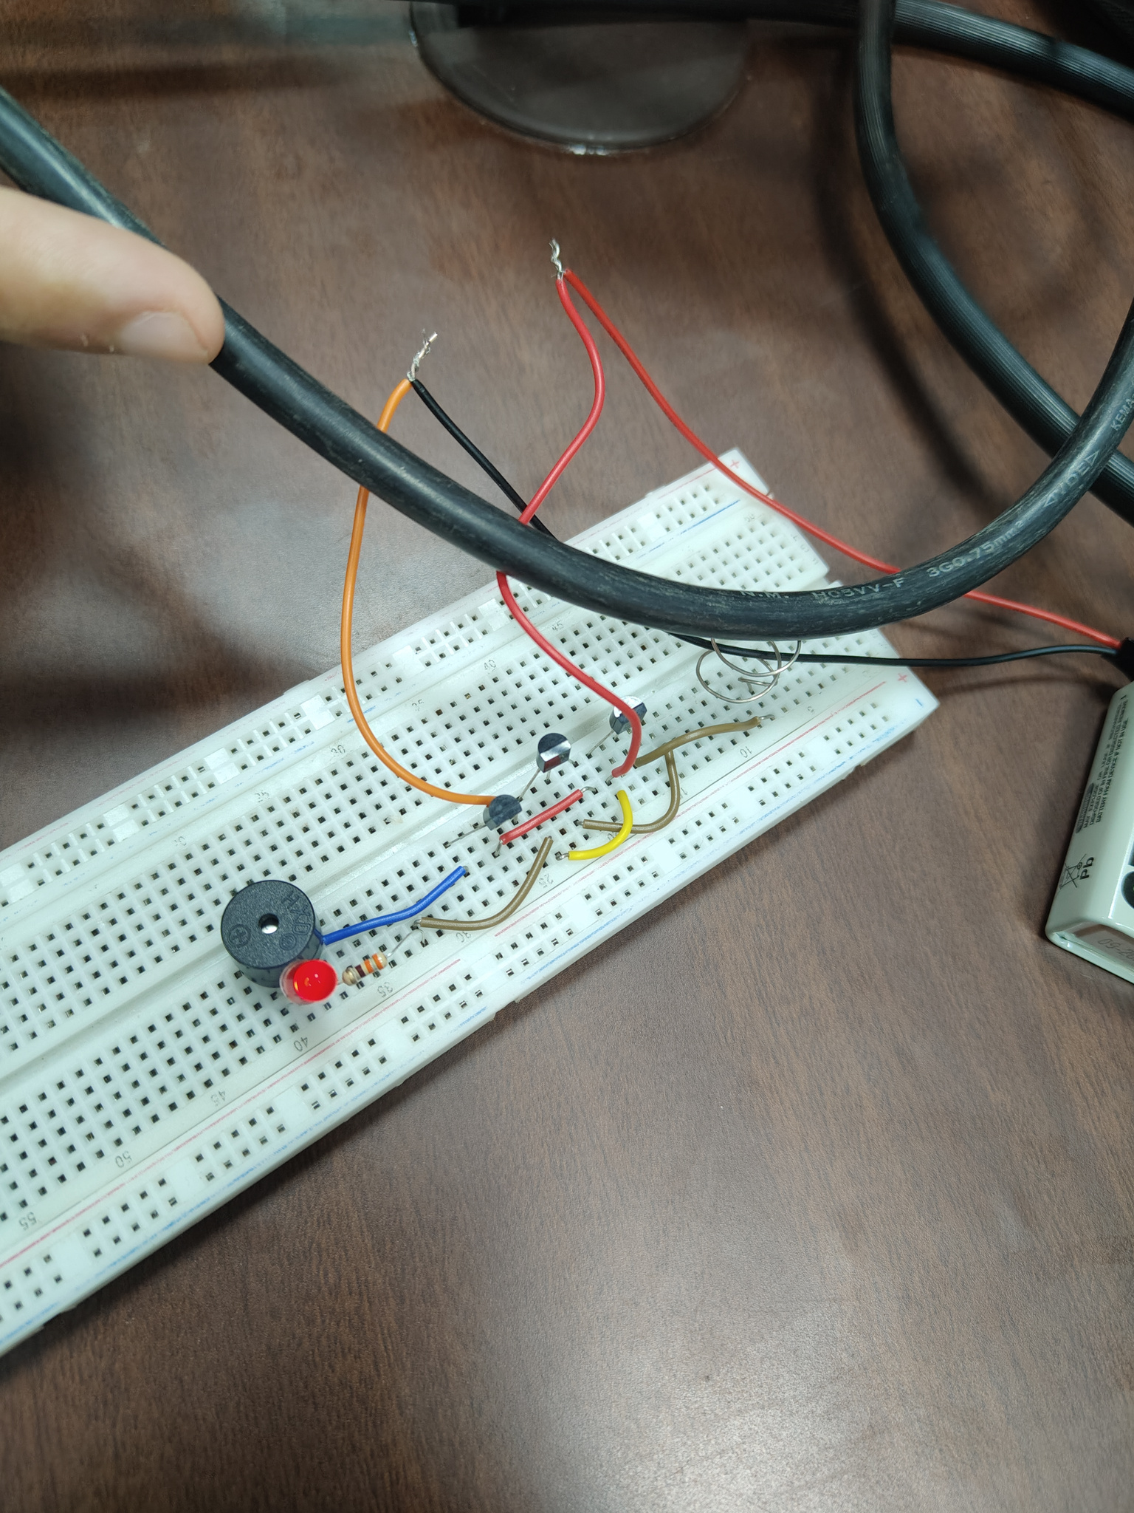
HARDWARE IMPLEMENTATION

Slide 28

HARDWARE IMPLEMENTATION

Slide 29
PRACTICAL APPLICATIONS
Electrical maintenance work.
Home appliance safety checks.
Industrial installation inspections.

Slide 30
REFERENCES
LM35 Temperature Sensor Datasheet
https://www.ti.com/lit/ds/symlink/lm35.pdf
LM3914 Dot/Bar Display Driver Datasheet
https://www.ti.com/lit/ds/symlink/lm3914.pdf
BC547 NPN Transistor Datasheet
https://www.onsemi.com/pdf/datasheet/bc547-d.pdf
Simulation Tool:
proteus
AC Voltage Detector Circuit Reference:
https://circuitdigest.com/electronic-circuits/simple-ac-voltage-detector-circuit

Slide 31
THANK YOU!

